Slide 1
WT-411i2 & WT-454i2 Considerations on Inventory & Topology
Haomian Zheng, Guoxiang Liu, Aihua Guo
May 30, 2023

Slide 2
Take-aways in C
Several sources suggest to reference a network equipment inventory from the network topology physical infrastructure layer
IETF Network HW inventory looks like a good reference for BBF equipment inventory TR 454 i2
Support and would like to start with “draft-ietf-ccamp-network-inventory-yang”, and feedback to IETF if we find any comments;
To clarify the relationship with the current ‘bbf-equipment-inventory’ and ‘bbf-network-map’, an overwrite?;
Only network HW (⬄ TR 454 EI also include pAN, (=PMA for access node))
Includes also node HW sub-components (chassis, slots, boards, cages) (⬄ TR 454 EI)
Does not include home devices (⬄ TR 454 EI)
draft-ietf-ccamp-network-inventory-yang defines a generic and hierarchical definition which in general also support home devices with new type definition. Technology-specific inventory attributes can be extended for ONU, AP, STA, ODN, see more details in the following pages.
We might also refer to multiple OSS subsystems NB of Access SDN M&C which represents reality (not only CloudCO DO)
Clarification: any example scenario?
Reference: https://wiki.broadband-forum.org/download/attachments/204472806/Inventory-Topology_4_17_2023.pptx?version=1&modificationDate=1681906477816&api=v2

Slide 3
Proposed Model Structures
ietf-network-hardware-inventory
ONU Augmentation
Home Gateway
Augmentation
Access Point
Augmentation
Others...
ietf-network-hardware-inventory defines a network-scope inventory model. It contains generic definitions for inventory objects as well as their hierarchical parent-child relationships.
Network element, chassis, card, port, link can be reused for access networks
Augmented inventory models for PON and home devices:
Inventory YANG model for ONU – defines ONU network-level inventory parameters for multiple PON types
Home gateway YANG model – defines service-level inventory parameters for home gateways
Used when the home gateway is separate from the ONU
Access point YANG model – defines inventory YANG models for Wi-Fi AP

Slide 4
ONU Inventory Model
Augments the ietf-network-hardware-inventory
Inherits common/generic attributes for inventory objects from the base model
Reuses common ONU attributes defined in the common YANG models
Consideration: need to align common attributes defined in the above two models
Key features in ONU Augmentations
Add ONU specific attributes for different PON types
Consideration: evaluate whether these ONU attributes are defined in separate containers or defined under the common container in ietf-network-hardware-inventory
Supports …

Slide 5
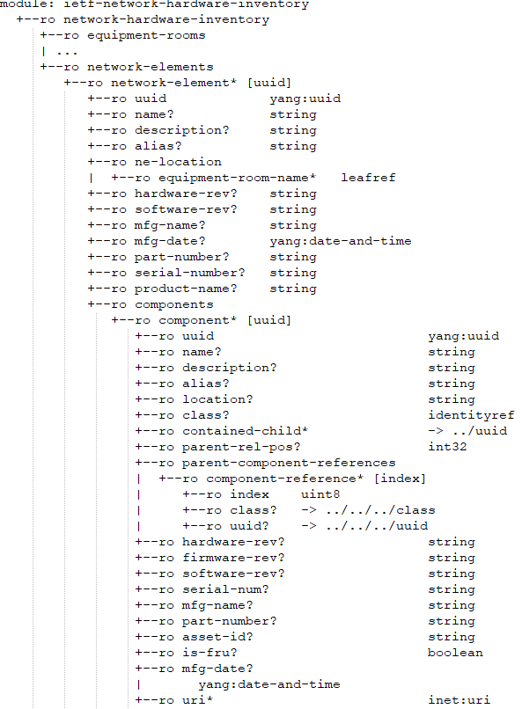
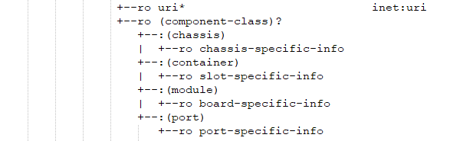
ONU Model Tree (Sample)
network-element : OLT
+--:(pon-port)
| +--ro pon-port-specific-info
+--:(onu)
+--ro down-bw?
+--ro ref-parent-ltp
+--ro pon-type
+--ro loid
+--ro voip-address
+--ro onu-id
+--ro fttx-mode
+--ro mac-address
+--ro onu-class
+--ro onu-type
+--ro bandwidth-type
+--ro terminal-type
+--ro tags
ONU component attributes
OLT→board→PON port-->ONU
ONU
Sample :
ONU specific attributes
Common reusable attributes

Slide 6
Home Gateway Inventory Model
Augments the ietf-network-hardware-inventory
Inherits common/generic attributes for inventory objects from the base model
Reuses common ONU attributes defined in the common YANG models per TR-383
Consideration: need to align common attributes defined in the above two models
Key features in home gateway augmentations
Definition of home gateway models

Slide 7
Home Gateway Model Tree (Sample)
...
|
+--ro home-gw
+--ro model?
Specific attributes for home gateways

Slide 8
Wi-Fi AP Inventory Model
Augments the ietf-network-hardware-inventory
Inherits common/generic attributes for inventory objects from the base model
Reuses common ONU attributes defined in the common YANG models
Consideration: need to align common attributes defined in the above two models
Key features in the augmentations
Common reusable grouping definition for APs
ssid-info, neighbor-ssid-info
uplink-pon-info
common-error-info
Extensible opaque attribute for vendor implementation
Definition for supported Wi-Fi bands
Definition for connected home devices

Slide 9
Summary
Augmented inventory data models for ONUs based on ietf-network-hardware-inventory
Reuse common attributes from the IETF base model and common YANG models

